Slide 1


Group S02-LT03
Jerod William-Davis, Tyler Freeman, Xueting Hu, Collin Van Allen

Slide 2



RDBMS Choice
We used MariaDB in our program for a multitude of reasons
Recommended by professor
Worked well with Java
Open source and lots of documentation available
We used a combination of Heidisql and Dbeaver for accessing and importing the data.
Dbeaver helped make the connections easier to see
Heidisql was helpful for importing data and running SQL scripts

Slide 3

Programming language selection
At first, we were split between a C based language or Java. We eventually went with java for a few reasons
Most of us had some practice with Java and knew how it worked
The JDBC libraries were available and easy to use
Many tutorials online and available documentation to gain an understanding
Java is available/compatible on most OS’s
Some of our groupmates were on Mac and not Windows, so java would allow all of us to contribute

Slide 4

Other programming info
We used Eclipse for programming in Java as it was a IDE that most of us were comfortable with
GitHub was used to share the program and data with other group members as we didn’t have an online server to work together on

Slide 5
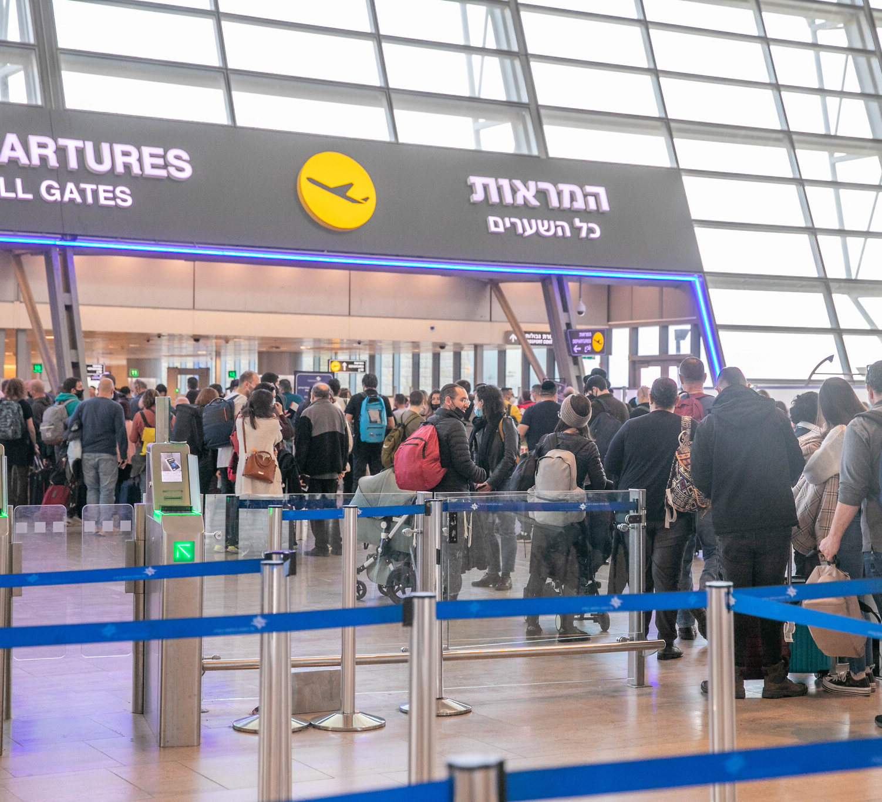
Our Application – Flight Manager
Airports are incredibly busy and managing the people coming in and out is hard work.
We decided to do a flight manager to help organize some of the chaos that might be at an airport

Slide 6
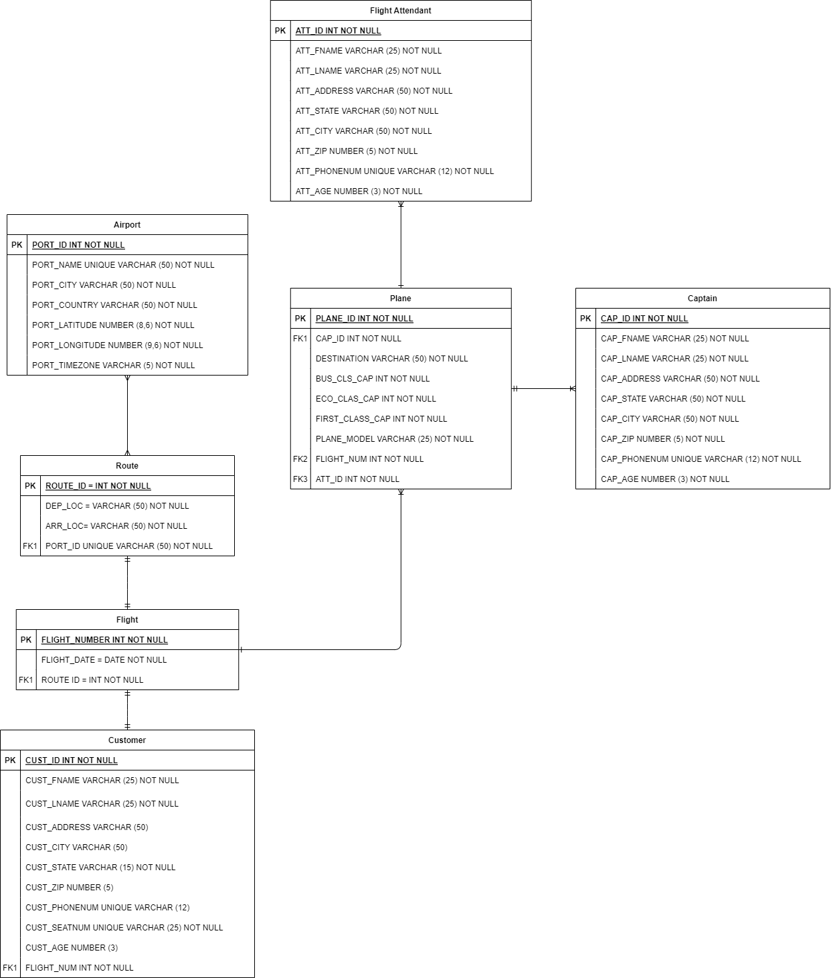
E.r. Diagram
Our database consists of 7 tables:
Captain
Every plane has 1 captain; needed to fly the plane
Flight Attendant
Every plane has 1 attendant, needed to take care of customers needs
Plane
Every flight has a plane so people can fly from one location to another

Slide 7
E.r. Diagram cont.
Airport
Every route must have an airport from which they depart and arrive at
Route
Contains the airport from which the airport departs along with the arrival airport location
Flight
Every flight contains a route and plane
Customer
Every customer has a flight assigned to them, and many customers can have the same flight

Slide 8

Challenges faced
Unable to work Synchronously
Coordinating Schedules / scheduling meetup times
Finding a language to program with, everyone had different skill levels

Slide 9
Project Demo

